Slide 1
Lecture 5:
Analyzing Risk: Modeling Input Data

Slide 2
Module 2 Study Guide and Deliverables
Topics: | Lectures 5: Analyzing Risk: Modeling Input Data Lectures 6: Analyzing Risk: Dealing with Correlated Data
Readings: | Lectures 5 and 6 online content
Discussions: | No discussion.
Assignments: | Assignment 3: Individual Assignment covering Lecture 5 and Lecture 6
Assessments: | Midterm covering Lectures 1 through 6

Slide 3
Learning Objectives
After you complete this lecture, you will be familiar with the following concepts:
The newsvendor problem
Developing input models to be used in simulation
Using resampling method to represent an uncertain input
Fitting a probability distribution to the data on hand
Chi-square test, Kolmogorov-Smirnov test
Q-Q plot, P-P plot
Using historical data itself in simulation
Breakpoints method
Mean and variability method

Slide 4
Newsvendor Problem¹
"Banana Republic, a division of Gap, Inc, was trying to build a name for itself in fashion circles. In one recent holiday season, the company has forecasted that the blue would be the top-selling color in wool sweaters. They were wrong. The number one seller was green and they did not have enough of the green sweaters.^{"2}
This example describes a practical situation in which one time purchase decision has to be made in the face of uncertain demand.

Slide 5
Newsvendor Problem¹
This problem is commonly referred to as newsvendor problem or newsboy problem: A newsboy (someone selling newspaper on the street) has to decide how many newspapers to purchase on a daily basis before observing the demand. Since the demand is uncertain, the newsboy runs the risk of over-purchasing or under-purchasing. More specifically, if he purchases too few newspapers, he will have the risk of not satisfying the demand and this will result in lost opportunity to increase profits as well as loss of goodwill. If he purchases too many newspapers, then he will have the risk of not being able to sell them all, which will result in loss because he has to discard the leftovers at the end of the day (today's newspaper is useless tomorrow).
In this module, we will be working with the following single-period purchasing decision problem:

Slide 6
Newsvendor Problem¹
In this module, we will be working with the following single-period purchasing decision problem:
Suppose that a small retail store anticipates on a Valentine's day, at least 40 wool socks (produced for Valentine's day) will be sold, but the actual amount is uncertain. A pair of socks costs $12 and sells for $18. After the Valentine's day, the unsold socks will be discounted 50% and are eventually sold.
The question is how many socks should this store purchase in the face of uncertain demand?
Source: Adapted from Evans, J. R., Business Analytics: Methods, Models, and Decisions, 2e, 2016, Pearson Education, Inc., p. 353

Slide 7
Newsvendor Problem¹
In this module, our goal is not to answer this question (the question will be answered in Lecture 7). Rather, our goal is to model the demand in several ways. So far, in our examples, we assumed that the demand (more generally, the uncertain input variable) comes from a specific distribution such as the normal distribution. However, this need not be the case (and in some, it is not appropriate to use a probability distribution to model the uncertain variable(s)). In this module, we will look at the problem of modeling uncertain input variables in more detail.
INDIVIDUAL EXERCISE
Before you read further, please try to build the spreadsheet model on your own. Assume a demand of 41 and purchase quantity of 44.

Slide 8
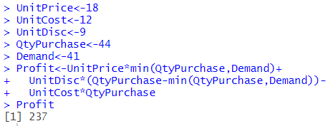
Newsvendor Problem¹
Figure 5.1 presents the R Code we use to model this problem, assuming a demand of 41 for now. We have made some assumptions just to be able to build our spreadsheet model for the newsboy problem. In particular, we have assumed a certain quantity of 41 for the demand. However, as we all know, in real life demand is uncertain. In the remainder of this module, we will be focusing on modeling the uncertain demand in several different ways.

Slide 9
Input Model Development
Input modeling is picking a model to represent the uncertainty or randomness in a stochastic simulation. Examples include
demand per unit time for inventory of a product
number of defective items in a shipment of goods
times between arrivals of calls to a call center
So far, we assumed that we are given these probability distributions as models; e.g., we assumed demand is normally distributed with a given mean and variance. In this module, we will learn how we choose these models; i.e., we will cover the topic of input modeling.
It is important to understand that input modeling is an art and that the picked input model will be only an approximation of the true input model.
Figure 5.2 presents the process of developing an input model for an uncertain variable.

Slide 10
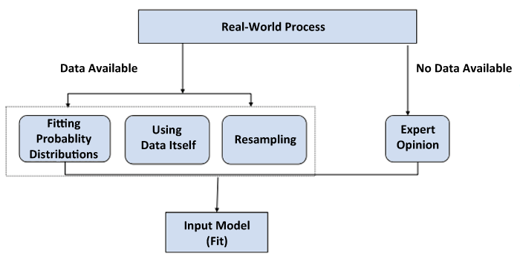
Input Model Development

Slide 11
Input Model Development
When data is available:
If you think that there is a physical basis for the sample data and you can use an analytical probability distribution to represent this physical phenomenon, then use the approach "fitting probability distributions". For instance, if the data represent the project completion times, then you can use the PERT distribution to model the data as we covered in Lecture 3. Therefore, it is important that we know the physical basis of the distributions; i.e., which distribution is appropriate to represent a particular uncertainty. We covered this in Lecture 3.
If you have large number of observations compared to the simulation replications you will perform, you can use the "historical data itself" approach.
If you have small number of observations compared to the simulation replications you will perform, you can use the "resampling" approach.

Slide 12
Input Model Development
When data is not available:
If available, use expert opinion to model the data.
If expert opinion is not available, use the literature for your industry and try to find example applications similar to yours.

Slide 13
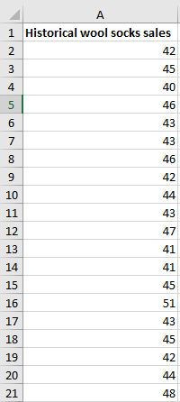
Input Model Development when Data is Available
Now let us assume that our small retail store has kept records for the past 20 years on the number of wool socks sold at full price during the Valentine's day. The data is shown in the spreadsheet in cells A2:A21 in Figure 5.3.

Slide 14
Using Historical Data Itself to Model the Sales Data
This approach is useful especially when one has large amounts of data compared to the simulation trials to be performed. Although, we have only 20 data points in our example, for the sake of completeness, we will still illustrate this approach with our newsvendor problem.
We first read our data into a data frame in R. In this case, our data is contained in a .csv file, so we use the read.csv function. We then perform our profit calculation for each level of historical demand.

Slide 15
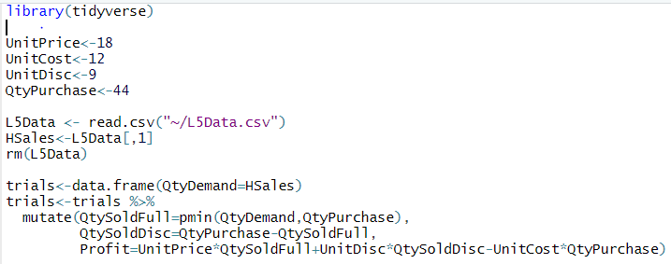
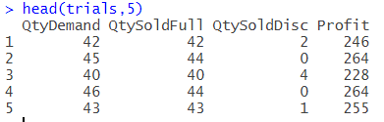
Using Historical Data Itself to Model the Sales Data
The R Code for this approach and the first 5 rows of data are reproduced in Figure 5.4:

Slide 16
Using Resampling to Model the Sales Data
To model the demand, we can resample from the historical sales data. More specifically, we select a value randomly from the historical sales data to represent the demand in the model. In other words, instead of randomly sampling a value from a probability distribution (as we have done so far in this course) for each trial of the simulation, we will sample a value for demand from the given historical sales data for each trial of the simulation. We can do this using the rdunif function from Lecture 3 to choose a random element of our list for each trial.

Slide 17
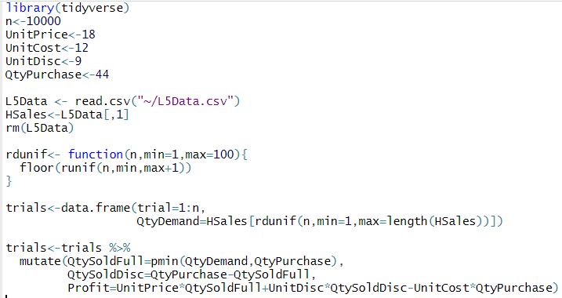
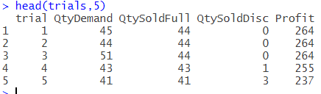
Using Resampling to Model the Sales Data
The R code and resulting rows of data are reproduced in Figure 5.5.

Slide 18
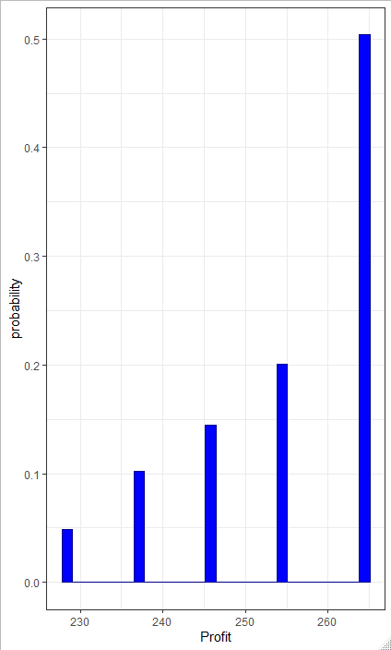
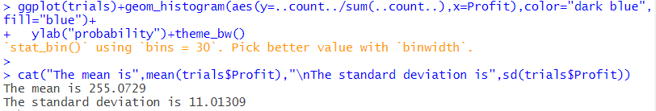
Using Resampling to Model the Sales Data
As before, we can produce a histogram and answer questions about the resulting profit distribution, seen in Figure 5.6

Slide 19
Using Resampling to Model the Sales Data
Despite the ease in its use, resampling has some shortcomings:
Useful when you have a small number of historical observations compared to the number of replications you want to run.
You can never go outside your observed data. This may limit your ability to predict uncertain events that may occur because you are limited with the range of the observed data; you cannot include likely values outside the range of the data.
It is difficult to reflect dependencies in the inputs.
Nonetheless, resampling is used frequently in practice.

Slide 20
Fitting a Probability Distribution to the Sales Data
The approach of fitting probability distributions to the demand data proceeds as follows:
Step 1: Find a probability distribution that will represent the data and fit this distribution to the data (i.e., determine values for its unknown parameters). One way of doing this is to use the physical characteristics of the process as illustrated in Lecture 3.
Step 2: Check the fit to the data via tests and graphical analysis.
Step 3: If the distribution does not fit, select another candidate and repeat the process, or use an empirical distribution ((e.g., resampling or a step-wise function).

Slide 21
Fitting a Probability Distribution to the Sales Data
Now, let us elaborate on these steps (these steps are difficult to perform by hand but are automatable in R. Please review them and try to grasp the big picture. You do not need to understand the specifics for the purpose of this course, nor do you need to exactly follow the R code for this section):
Step 1: In this step, our goal is to find a probability distribution along with its parameters to represent the data on hand. A good way to start this step is to use the physical characteristics of the process. For instance, if you are modeling the project completion times, then you know that PERT is a good distribution to represent the project completion times.

Slide 22
Fitting a Probability Distribution to the Sales Data
After we choose a distribution to represent the data on hand, the next step is to estimate the parameters of the distribution. For instance, let us assume that we have chosen the normal distribution to represent the data. The next question is "what values should the parameters of the normal distribution take?"
The estimation of the parameters is usually done by a method called the "maximum likelihood estimation method". The resulting parameter estimates are called "maximum likelihood estimators". There are different maximum likelihood estimators for the parameters of different distributions.

Slide 23
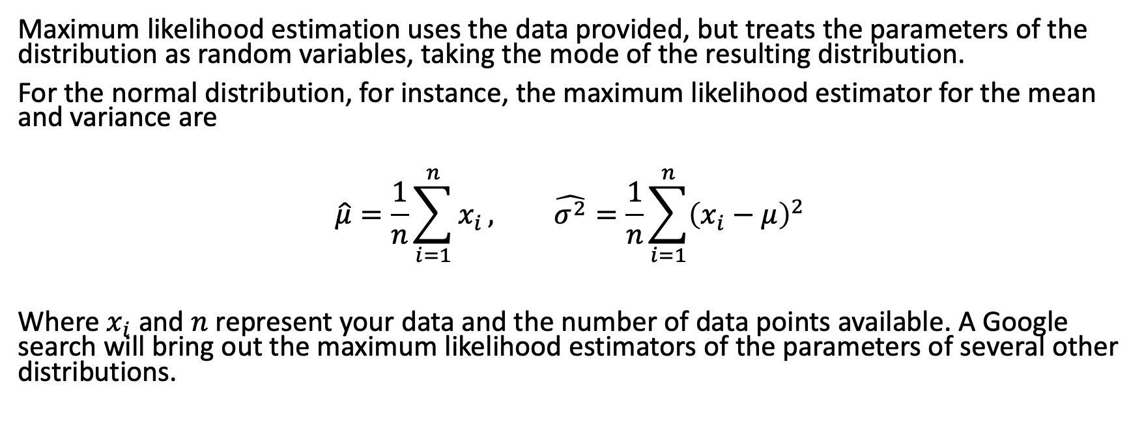
Fitting a Probability Distribution to the Sales Data
Maximum likelihood estimation uses the data provided, but treats the parameters of the distribution as random variables, taking the mode of the resulting distribution.
For the normal distribution, for instance, the maximum likelihood estimator for the mean and variance are
$$\hat{μ}=\frac{1}{n}\sum_{i=1}^{n}{x_{i}}, \hat{σ^{2}}=\frac{1}{n}\sum_{i=1}^{n}{{\left(x_{i}−μ\right)}^{2}}$$
Where $x_{i}$ and $n$ represent your data and the number of data points available. A Google search will bring out the maximum likelihood estimators of the parameters of several other distributions.

Slide 24
Fitting a Probability Distribution to the Sales Data
Step 2: After we find a probability distribution to represent the data, the next question we ask is "Is the distribution we identified really a good fit to the data?" We answer this question with the help of the goodness-of-fit tests and graphical comparisons:
Goodness-of-fit tests
Chi-squared test
Kolmogorov-Smirnov (KS) test
Anderson-Darling (AD) test
AIC/BIC test
Graphical comparisons
Histogram-based plots
Probability plots
P-P plot
Q-Q plot
Now, let us review the goodness-of-fit tests and the graphical methods briefly.

Slide 25
Fitting a Probability Distribution to the Sales Data
Goodness-of-fit tests: Chi-square test provides a formal comparison of a histogram (for continuous data) or line graph (for discrete data) with the fitted density (for continuous data) or mass function (for discrete data).
The KS and AD tests, on the other hand, compare an empirical distribution function with the distribution function of the hypothesized distribution. AD test detects discrepancies in the tails and has higher power than KS test.
AIC and BIC use a likelihood function to find the distribution that best fits the data on hand.
The KS, AD and AIC/BIC tests are only useful in the presence of continuous data. For discrete data we have to use the Chi-square test.
Note: In comparing several candidate distributions to represent the data, the smaller the KS test statistic/AD test statistic/Chi-square test statistics/AIC-BIC values, the better the fit.

Slide 26
Fitting a Probability Distribution to the Sales Data
Graphical comparisons: Histogram-based plots compare (graphically) a histogram of the data with the density function of the fitted distribution. They are sensitive to how we group the data when forming the histogram. Probability plots, on the other hand, graphically compare an estimate of the true distribution function of the data with the distribution function of the fit.
Q-Q (P-P) plot amplifies differences between the tails (middle) of the model and sample distribution functions. If the distribution chosen is a good fit, the Q-Q and the P-P plot will be approximately linear (i.e., will lie on the y=x line).
Note:
Use every graphical tool to examine the fit.
If histogram-based tool, then play with the widths of the cells.
Q-Q plot is very highly recommended!
When different plots provide different insights, it is generally the Q-Q plot that we will rely on.
Source: Adapted from Biller, B. and B. L. Nelson. 2002. Answers to the Top Ten Input Modeling Questions. Proceedings of the 2002 Winter Simulation Conference, eds. E. Yucesan, C.-H. Chen, J. L. Snowdon, and J. M. Charnes, pp. 38

Slide 27
Fitting a Probability Distribution to the Sales Data
Step 3: After careful analysis in Step 2, if you decide that the distribution that you have chosen in Step 1 is not a good fit to the data on hand, and you need to go back to Step 1 and choose another distribution and perform Step 2 and Step 3 again. You continue this process until you are satisfied that the distribution that you chose in Step 1 represents the data on hand.
It is important to note that these three steps are very time-consuming and are not easy to perform without the help of a software program. Fortunately, R can automate this process with several distributions.

Slide 28
Fitting with R
In order to fit a distribution with R, we combine the fitdistr function from the MASS library with the test statistic of our choice. Here I use the goodfit function from the vcd library to find the best fit for sales, comparing the three available distributions, shifted several times. Next lecture, we will use the fitdistrplus library to perform both functions. The fitdistr function finds the MLE of parameters for the best fitting result. We find the best fit we can get is the negative binomial distribution, shifted to the right by 40.
The code, along with histograms comparing the two distributions, and a qqplot, are reproduced in Figure 5.08.

Slide 29
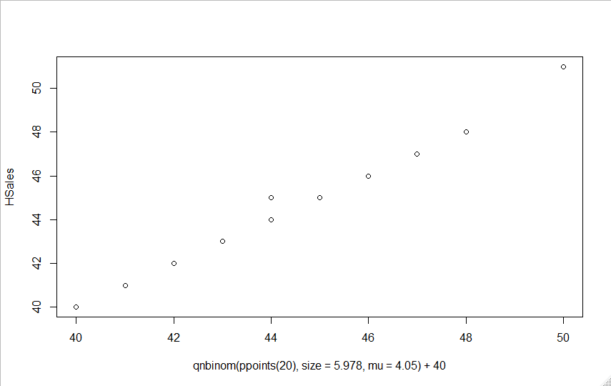
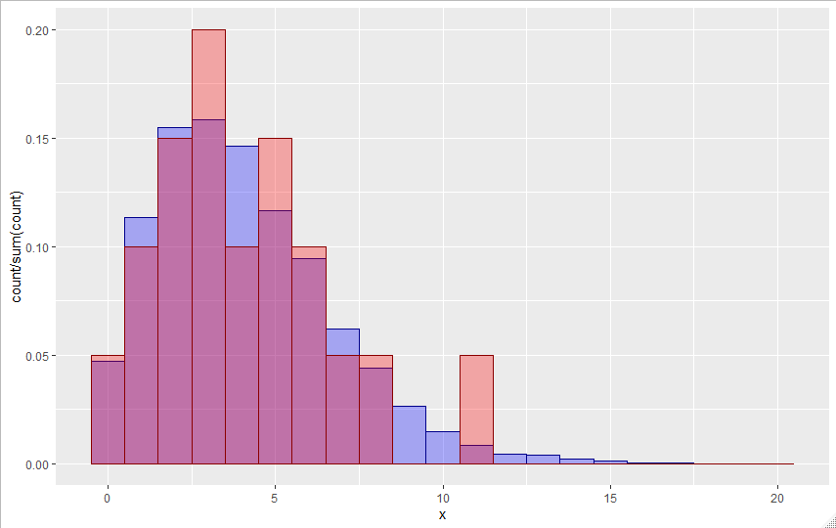
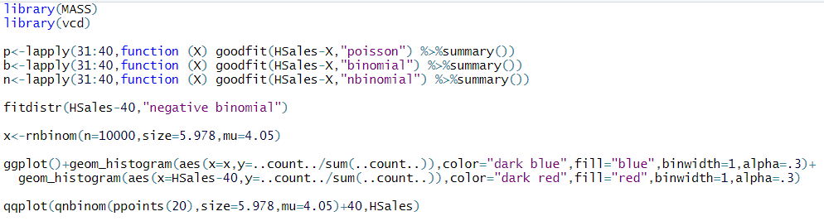
Fitting with R

Slide 30
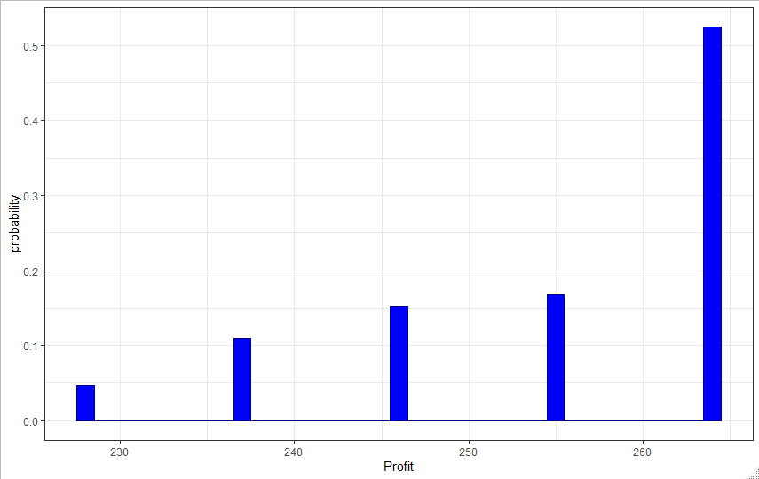
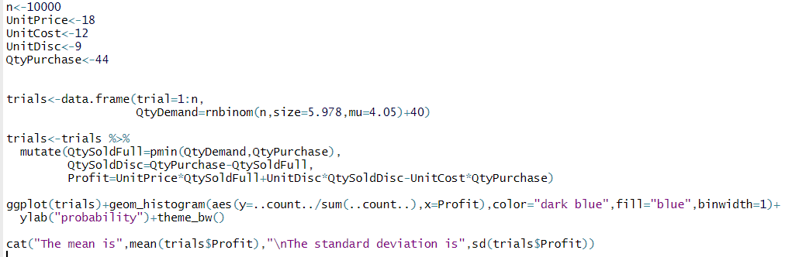
Fitting with R
If we’re satisfied with the resulting fit, we can replace our historical data with the new distribution in a data frame. The code and resulting histogram are displayed in Figure 5.09.

Slide 31
Input Modeling When Data is Not Available
If we have no data to model an uncertain variable in our model, then we have to use anything we can find including
Expert opinion
Physical or conventional limitations (can provide bounds)
Physical basis of the process (can suggest appropriate distribution families).
Source: Adapted from Biller, B. and C. Gunes. 2010. Introduction to Simulation Input Modeling. Proceedings of the 2010 Winter Simulation Conference, eds. B. Johansson, S. Jain, J. Montoya-Torres, J. Hugan, and E. Yucesan, section "When No Data are Available", p. 52.
In this section, we will learn about two general methods used to model the expert opinion:
Breakpoints method
Mean and variability method

Slide 32
Breakpoints method
Assuming that we are trying to model the demand of a product and we are given by the expert that demand is likely to be no less than 100 units but no more than 500 units, we can use uniform distribution with parameters 100 and 500 to model this demand process.
Source: Biller, B. and C. Gunes. 2010. Introduction to Simulation Input Modeling. Proceedings of the 2010 Winter Simulation Conference, eds. B. Johansson, S. Jain, J. Montoya-Torres, J. Hugan, and E. Yucesan, section "When No Data are Available", pp. 52-53
Why uniform distribution? Because we are only given bounds 100 and 500 for the demand and all values in between 100 and 500 are equally likely.

Slide 33
Breakpoints method
If we are additionally given the information that demand is most likely to be 350 units, then we can use the triangular distribution with parameters 100, 350, and 500 to model this demand process.
The ideal information that can be gained from the expert is the breakpoints of the process. Breakpoints are values and each value is associated with a percentage of being less than itself.
Source: Biller, B. and C. Gunes. 2010. Introduction to Simulation Input Modeling. Proceedings of the 2010 Winter Simulation Conference, eds. B. Johansson, S. Jain, J. Montoya-Torres, J. Hugan, and E. Yucesan, section "When No Data are Available", pp. 52-53

Slide 34
Breakpoints method
Now assume that we are given by the expert the following information: The demand of the product will be between 100 and 500 units with 25% chance of being less than 200, 75% chance of being less than 350, and 99% chance of being less than 450.
For this we can combine a runif call with an rdunif call. The first will determine which of the three demand results occur. The code to do so is reproduced in Figure 5.10, along with a histogram giving an idea of the pmf.

Slide 35
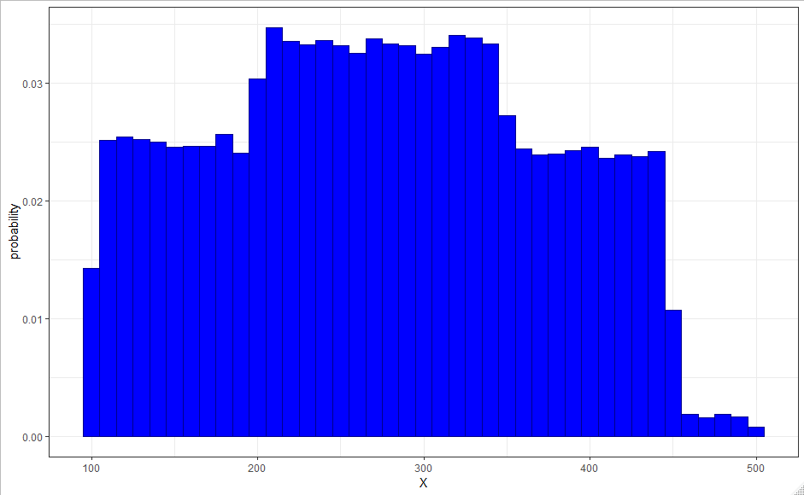
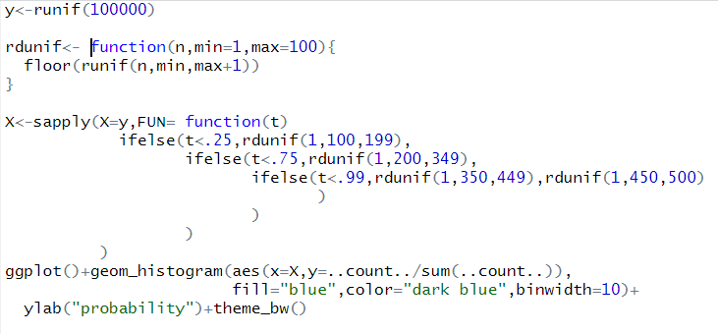
Breakpoints method

Slide 36
Lecture 5 Footnotes
¹ Adapted from Evans, J. R., Business Analytics: Methods, Models, and Decisions, 2e, 2016, Pearson Education, Inc., pp. 353. ² Louise Lee, "Yes, We Have a New Banana" Business Week (May 31, 2004): pp. 70-72.

Slide 37
Lecture 5 References
Evans, J. R., Business Analytics: Methods, Models, and Decisions, 2e, 2016, Pearson Education, Inc., p. 353.
Louise Lee, "Yes, We Have a New Banana" Business Week (May 31, 2004): 70–72.

Slide 38
Lecture 5 Summary Questions
What is "input modeling"?
Please comment on the following statement "There is no true input model for any uncertain input".
What are the input modeling methods that we can use in the presence of data?
What are the input modeling methods that we can use in the absence of data?
What are the disadvantages of resampling?
Assume that we are given by the expert the following information: The demand of the product will be between 250 and 750 units with 25% chance of being less than 300, 75% chance of being less than 550, and 99% chance of being less than 600. How would you model this situation?

